Slide 1
JavaScript part 3
Barb Ericson
Georgia Institute of Technology
May 2006

Slide 2
Learning Goals
Computing Concepts
  How to open another window in JavaScript
    How to modify properties of another window
  How to work with objects in JavaScript
    Objects have properties (like Java fields)
  How to create a form
    And user interface elements in a form
  How to do multimedia in JavaScript
    Simple animation

Slide 3
Opening Another Window
To open another window, we use the function open()
Open can take up to three inputs:
  First input is the URL to open.
  Second is the name of the window
  Third is a string with a variety of inputs possible.

Slide 4
Popping up a Window on a Click
<html>
<head>
<title>The Simplest Possible Web Page</title>
<script>
function goToHawaii()
{
var win=open('http://www.cc.gatech.edu/~mark.guzdial/hawaii/','Hawaii');
}
</script>
</head>
<body>
<h1>A Simple Heading</h1>
<p>This is a very simple web page.</p>
<p><image src="mediasources/beach.jpg" onClick="goToHawaii()" />
This page was created on <script> document.write(Date()); </script></p>
</body>
</html>

Slide 5
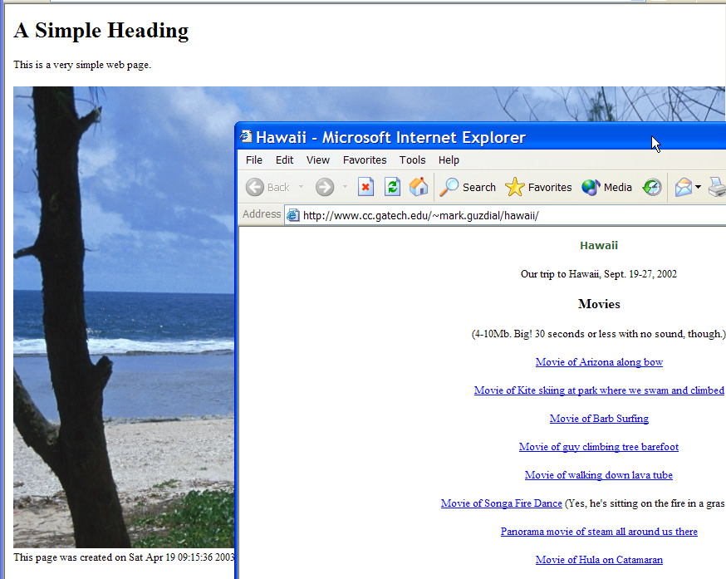
Popping up a Window

Slide 6
Changing the Window’s Characteristics
<head>
<title>The Simplest Possible Web Page</title>
<script>
function goToHawaii()
{
var win=
open('http://www.cc.gatech.edu/~mark.guzdial/hawaii/','Hawaii',
"titlebar=no,width=200");
}
</script>
</head>

Slide 7
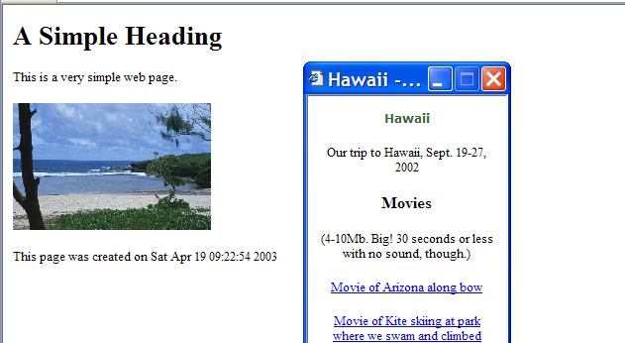
Changing the window’s characteristics

Slide 8
JavaScript Works with Objects
The HTML Page is a document object
You also can work with window objects
  Windows have properties you can change
    Like the width and whether to have a title bar
The current object can be referred to as this
  Just like in Java
  Text has a style and color is one property of style

Slide 9
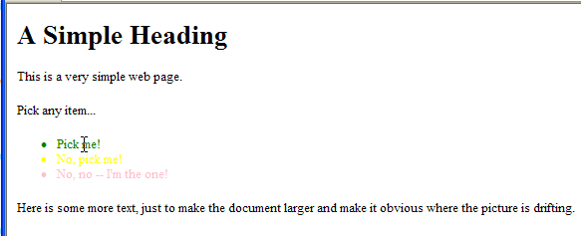
Changing Colors on Mouse Movement
<body>
<h1>A Simple Heading</h1>
<p>This is a very simple web page.</p>
<p>Pick any item...</p>
<ul>
<li onmouseover="this.style.color='green'"
onmouseout="this.style.color='black'">Pick me!</li>
<li onmouseover="this.style.color='red'"
onmouseout="this.style.color='yellow'">No, pick me!</li>
<li onmouseover="this.style.color='magenta'"
onmouseout="this.style.color='pink'">No, no -- I'm the one!</li>
</ul>

Slide 10
Fields and Buttons in HTML
To create fields and buttons in HTML, we need a form.
  Forms are delimited with <form> and </form>
Examples of things we can have in forms.
  <input type="text" name="afield1">
  <input type="button" value="Click me">
  type="textarea" for > 1 line of text
  type="radio" is for radio buttons
    only one radio button can be pushed at a time

Slide 11
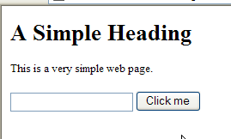
Simple Form
<html>
<head>
<title>Simplest Form in HTML</title>
</head>
<body>
<h1>A Simple Heading</h1>
<p>This is a very simple web page.</p>
<form>
<input type="text" name="afield">
<input type="button" value="Click me">
</form>
</body>
</html>

Slide 12
Exercise
Create a web page that has a button in it and when you click on the button change the background color of the button
  Or show a dialog box that says you clicked on the button
Create a Web page that has a button on it and each time you click the button update the page to show the number of times you have clicked the button
  Or use a dialog to show the number of times
Create a Web page with radio buttons on it and change the text that is displayed based on which button has been clicked
  Or use a dialog to show which radio button has been clicked

Slide 13
Forms and CGI Scripts
Forms can also point to particular URLs
  Form URLs are typically CGI Scripts
  CGI Scripts are programs (written in Perl, Python, C, Java, etc) that will process the form, which will be passed in as a parameter.
We can also do processing of form input completely from within JavaScript.

Slide 14
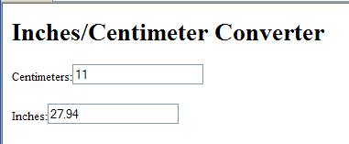
Inches/Centimeter Converter
<body>
<h1>Inches/Centimeter Converter</h1>
<form>
<p>Centimeters:<input type="text" name="cm"
onchange="this.form.inches.value=this.value / 2.54"></p>
<p>Inches:<input type="text" name="inches"
onchange="this.form.cm.value = this.value * 2.54"></p>
</form>
</body>

Slide 15
Doing Multimedia in JavaScript
It’s possible to do multimedia in JavaScript, but not like in Java.
  We can’t control pixels or sample values.
The most common way to do multimedia is through plugins.
  Like Apple QuickTime, RealVideo, Netscape LiveAudio
You can do some simple animations from JavaScript.

Slide 16
Animated Motion in JavaScript
There is a setInterval() function that can make a JavaScript function run at regular intervals.
  We use that to schedule motion to occur.
Divisions (<div></div>) can be controlled with styles, that can have positions.
We then make a function to adjust the position of the division.

Slide 17
Animated Motion in JavaScript
<html>
<head>
<title>The Simplest Possible Web Page</title>
<style>
#barb { position: absolute; left:0; top: 0; }
</style>
<script>
function drift()
{
var object = document.all.barb.style;
object.pixelTop = object.pixelTop + 5;
object.pixelLeft = object.pixelLeft + 5;
}
</script>
</head>
<body ONLOAD="setInterval('drift()',100)">
<h1>A Simple Heading</h1>
<p>This is a very simple web page.</p>
<div id="barb">
<p><image src="mediasources/barbara.jpg" />
</p>
</div>
<p>Here is some more text, just to make the document larger and make
it obvious where the picture is drifting.
</body>
</html>
Notes:
The <style> and </style> tags create a style of text which we use latter with the <div> tag.

Slide 18
Why use JavaScript?
To do simple processing from within HTML
  Check input values on forms for correct values
  Notify the user
  Simple interaction with the user
    Like changing an image
To control plugins for multimedia in Web pages

Slide 19
Summary
You can open other windows in JavaScript
  And control how they look
JavaScript works with objects
  Objects have properties
You can create forms
  And add user interface elements
You can control multimedia plug-ins
You can do simple animation with JavaScript

